Slide 1
WOUND HEALING
DR. MWEA MACHARIA

Slide 2
HISTORY
Egyptians. 3000BC. Differentiated clean/infected wounds
1650 BC: 48 different types of wounds described
1550 BC. Use of honey/ lint/ grease
Greece: differentiated acute/ chronic wounds
1850: Joseph Lister. Used phenol; antiseptic

Slide 3
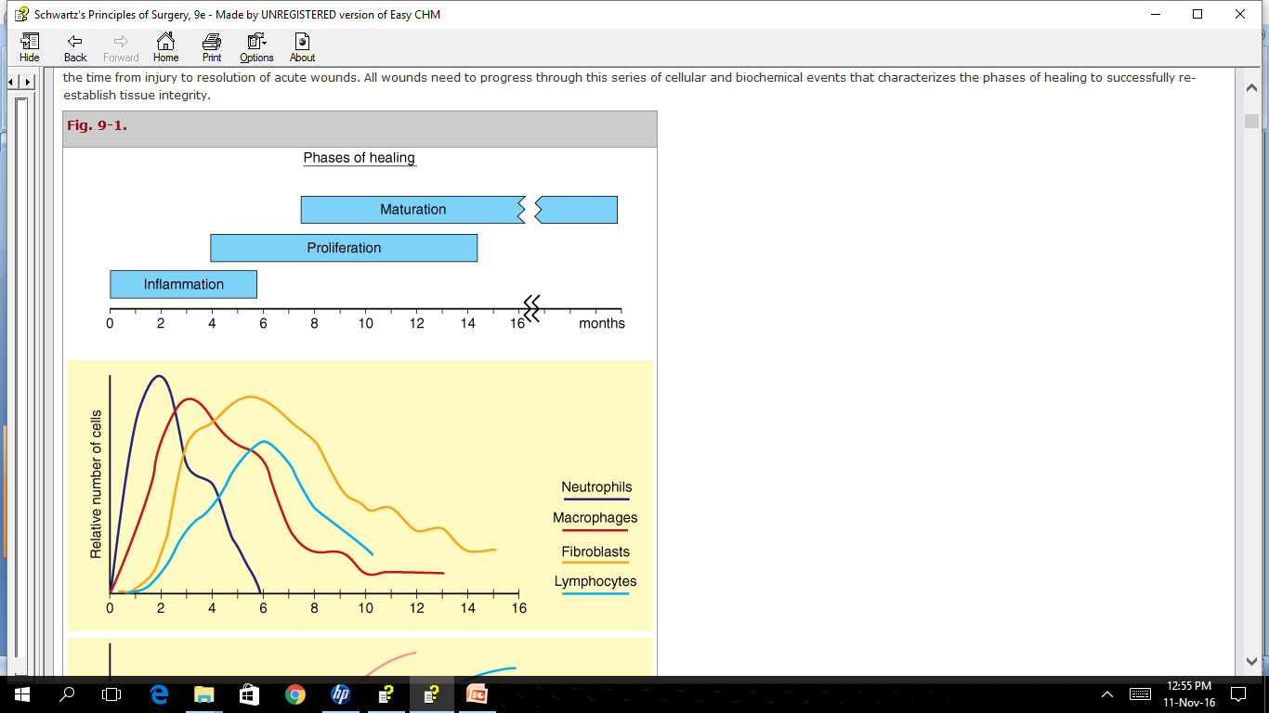
Phases of wound healing
Hemostasis and inflamation
Proliferation
Maturation and remodelling

Slide 4
Hemostasis and inflamation
Damage to tissues and blood vessels
Exposure of sub-endothelial collagen
Platelet aggregation/degranulation
Activation of complement and coagulation
Increased vascular permiability
Increased arterial vasodilation
Entry of neutrophills, macrophages, lymphocytes
Production of cytokines and growth factors

Slide 5
Cytokines
Interleukin 1, interleukin 6, tumor necrosis factor alpha
Growth factors
TGF-b, ILGF, EGF, VEGF, PDGF
FUNCTION OF CYTOKINES/ GROWTH FACTORS
Modulate Cell recruitment
Modulate matrix synthesis and breakdown
Modulate angiogenesis

Slide 6
Cells involved
Platelets:
PDGF, TGF-BETA, PAF, fibronectin,
Hemostasis. Platelet plug. Chemotaxis. Cell recruitment
Neutrophils:
TNF-ALPHA. Collagenases. Oxygen radicals
Phagocytosis, debridement, collagen synthesis, angiogenesis, cell recruitment
Lymphocytes:
Modulate transition to proliferative phase

Slide 7
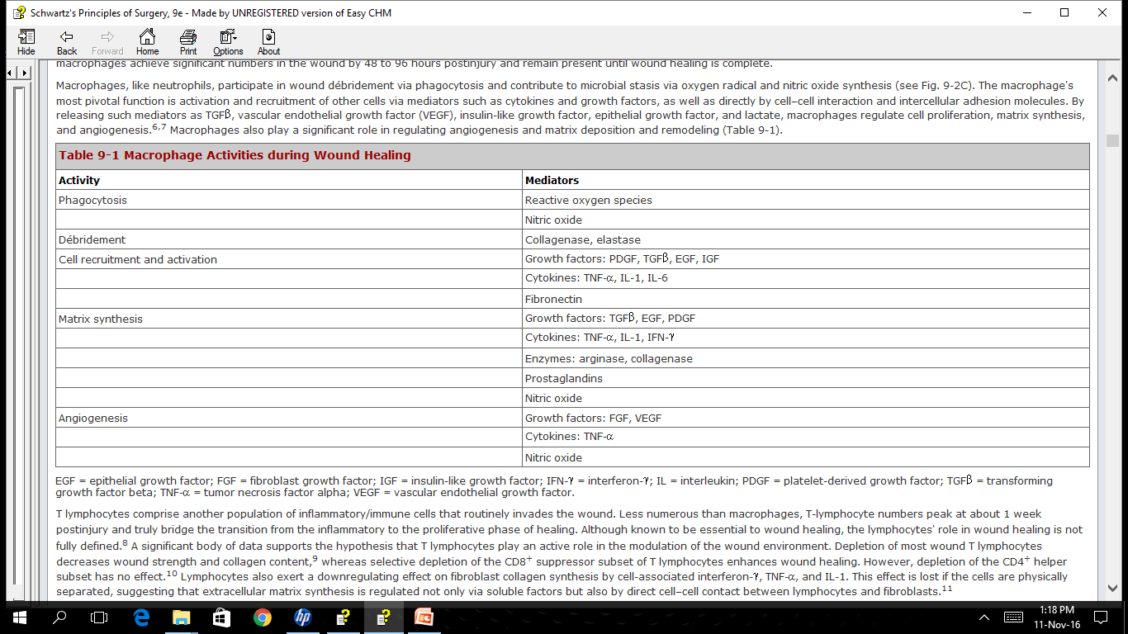
macrophages

Slide 8
Proliferative stage
Lasts from day 4- 12
Fibroblasts: collagen and glycosaminoglycans
Endothelial cells: neo vessels

Slide 9
Collagen synthesis
cellular/ rough endoplasmic recticulum
MRNA AMINO ACIDS PROTOCOLLAGEN
PROTOCOLLAGEN PROCOLLAGEN
extracellular
PROCOLLAGEN COLLAGEN

Slide 10
GLYCOSYLATION-HYDROXYLATION of PROTOCOLLAGEN
Of proline and lysine molecules.
Requires oxygen and iron as co-factors
Vitamin c as electron donor
Alpha keto glutarate as co-substrate
GLYCOSAMINOGLYCANS
Dermatan/ chondroitin sulphate
proteoglycans
Forms lattice with collagen

Slide 11
Maturation/re-modelling
Lasts weeks to months
Metallo-proteases: collagen breakdown
Balance of collagen synthesis and breakdown
Cross-linking of collagen fibrils
From collagen type 3 to type 1
Strength is never the same
Wound contraction: myofibroblasts

Slide 12
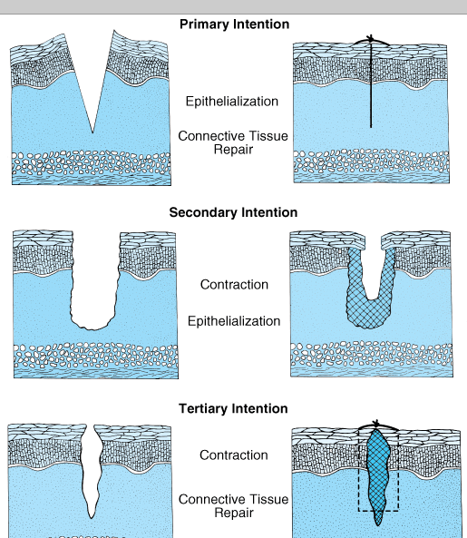
Types of wound healing
Primary intention
Secondary intention
Tertiary intension
Types of wounds
Acute wound
Chronic wound

Slide 13
Factors affecting wound healing
Local
Foreign bodies
Irradiation
Infection
Oedema
Mechanical stress
Systemic
Immunosuppresion
Anaemia
Metabolic factors e.g. diabetes
Malnutrition
Age
smoking

Slide 14
Chronic wounds
Diabetic wound
Arterial ischemic wound
Venous ulcer
Decubitus Pressure ulcers

Slide 15
Ecxessive healing
Keloids
Hypertrophic scars
adhesions

Slide 16
Wound treatment
Surgical debridement
Dressing
Primary wound closure
Skin grafting
Skin substitutes

Slide 17
Dressing materials
Gauze
Hydrocolloids
Alginates
Hydrofibre
Negative pressure dressing

